Slide 1
Agenda
Day1 | Fundamentals of Machine Learning: Introduction to Machine Learning and its Applications, Machine Learning Python Tools. Simple machine learning application. Data Preprocessing: Data Sets, importing libraries, Missing Data, Categorical Data, Splitting the Data Set into Training Set and Test Set, Feature Extraction and Preprocessing
Day2 | Types of Machine Learning Algorithms Bayesian Learning: Bayes Theorem and Concept Learning, ML and LS error Hypothesis, Naïve Bayes Classifier, Bayesian belief networks, EM Algorithm
Day 3 | Instance Based Learning: Introduction, K-nearest neighbor learning, locally weighted regression, radial basis function, cased based reasoning. Reinforced Learning: Introduction, Learning Task, Q Learning

Slide 2
Day 1
Fundamentals of Machine Learning Data Preprocessing

Slide 3
1.Fundamentals of Machine Learning
Why Machine Learning
What is Machine Learning ?
How Does ML Works
ML Applications
ML Use Cases
Understanding ML using Analogy
AI , ML and DL
Machine Learning Python Tools.
Simple machine learning application.

Slide 4
Why Machine Learning ?

Slide 5
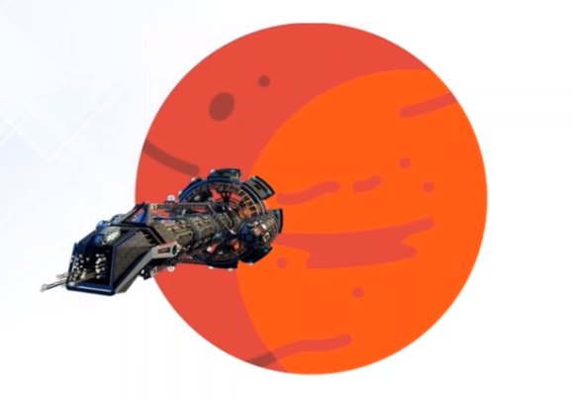
a. Why Machine Learning ?
Navigation on Mars or Deep ocean Where no humans are present

Slide 6
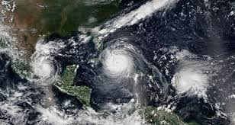
a. Why Machine Learning ?
Analyzing huge sensor data and predicting the outcome eg: in Forecasting Systems is not possible by manual calculations

Slide 7
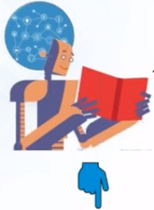
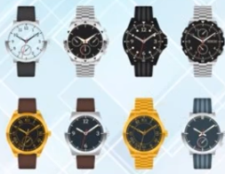
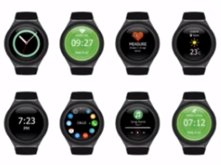
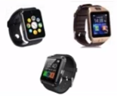
Recommending a product to buyers e.g. used by amazon , flipkart , Snapdeal etc., is not possible by manual calculations
Purchase History of a Customer
Search list of a Customer
a. Why Machine Learning ?

Slide 8
b. What is Machine Learning ?

Slide 9

b. What is Machine Learning ?
Is a type of Artificial Intelligence that provides computers with the ability to learn without being explicitly programmed.
Machine Learning is a concept which allows the machine to learn from examples and experience, and that too without being explicitly programmed.
So instead of you writing the code, what you do is you feed data to the generic algorithm, and the algorithm/ machine builds the logic based on the given data.
ML enables the computers or the machines to make data-driven decisions rather than being explicitly programmed for carrying out a certain task. These programs or algorithms are designed in a way that they learn and improve over time when are exposed to new data.

Slide 10
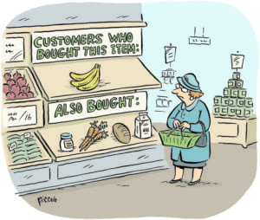

b. What is Machine Learning?
Have you ever shopped online? So while checking for a product, did you noticed when it recommends for a product similar to what you are looking for? or did you noticed “the person bought this product also bought this” combination of products. How are they doing this recommendation? This is machine learning.
Did you ever get a call from any bank or finance company asking you to take a loan or an insurance policy? What do you think, do they call everyone? No, they call only a few selected customers who they think will purchase their product. How do they select? This is target marketing and can be applied using Clustering. This is machine learning.

Slide 11
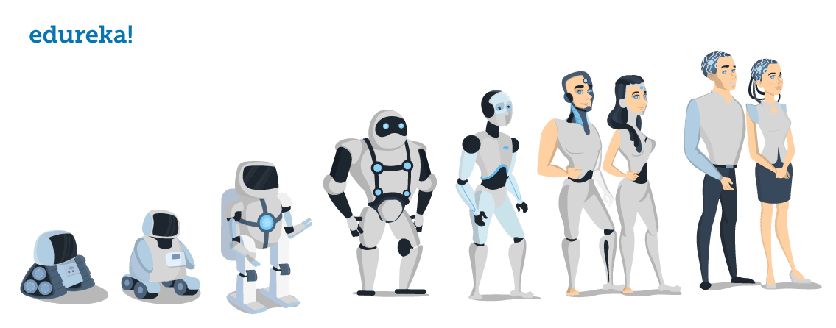
Evolution of Machines

Slide 12
c. How does Machine Learning Works ?

Slide 13
c. How does Machine Learning Work?
Machine Learning algorithm is trained using a training data set to create a model. When new input data is introduced to the ML algorithm, it makes a prediction on the basis of the model.
The prediction is evaluated for accuracy and if the accuracy is acceptable, the Machine Learning algorithm is deployed. If the accuracy is not acceptable, the Machine Learning algorithm is trained again and again with an augmented training data set.
This is just a very high-level example as there are many factors and other steps involved.

Slide 14
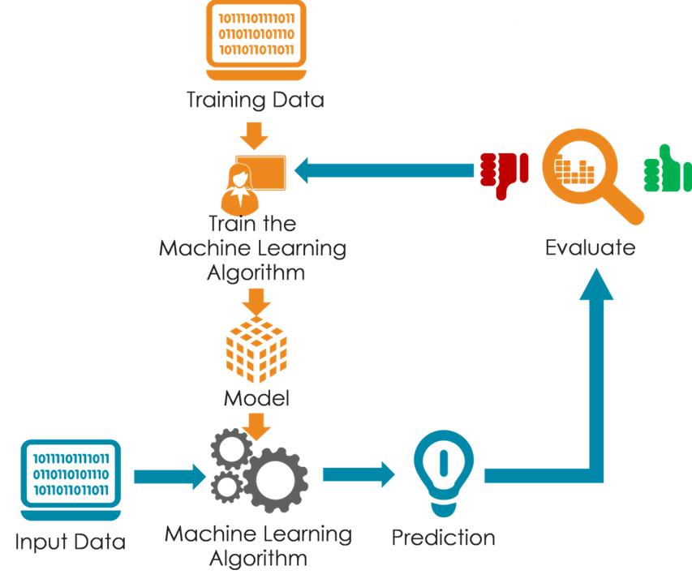

Slide 15


Slide 16
d. Machine Learning Applications
Virtual Personal Assistants : Siri, Alexa and Google Now
Predictions while Commuting: Traffic Predictions, Online Transportation Networks
Videos Surveillance :
Social Media Services: People You May Know, Face Recognition, Similar Pins
Email Spam and Malware Filtering
Online Customer Support
Search Engine Result Refining
Product Recommendations
Online Fraud Detection

Slide 17
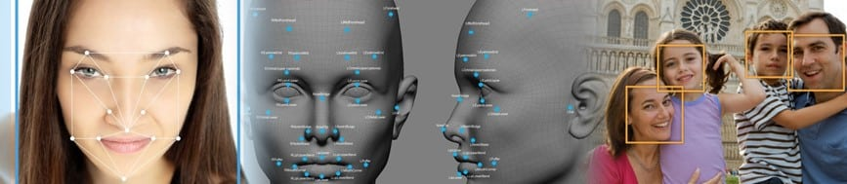
d. Machine Learning Use Cases
Face Detection.

Slide 18

Cortana is a virtual assistant created by Microsoft for Windows 10, Windows 10 Mobile, Windows Phone 8.1,Invoke smart speaker, Microsoft Band, Xbox One, iOS, Android, Windows Mixed Reality, and soon Amazon Alexa.
Cortana can set reminders, recognize natural voice without the requirement for keyboard input, and answer questions using information from the Bing search engine.
Cortana is currently available in English, Portuguese, French, German, Italian, Spanish, Chinese, and Japanese language editions, depending on the software platform and region in which it is used.

Slide 19
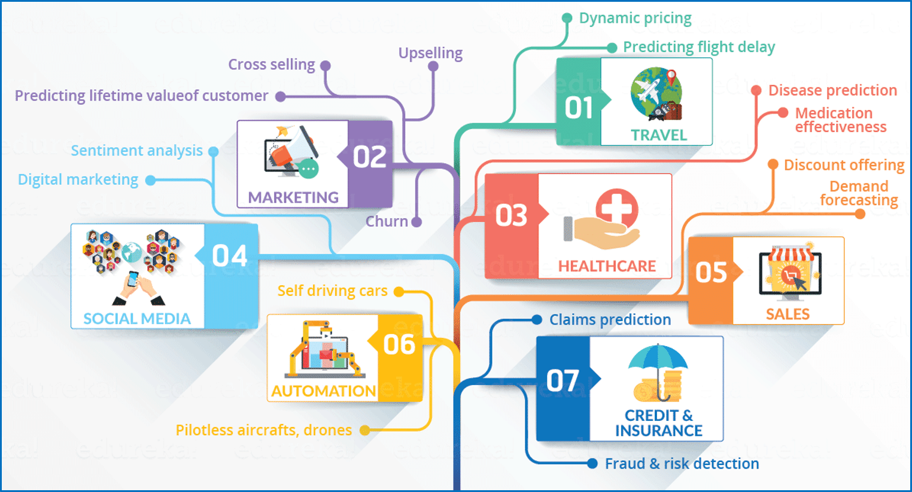

Slide 20
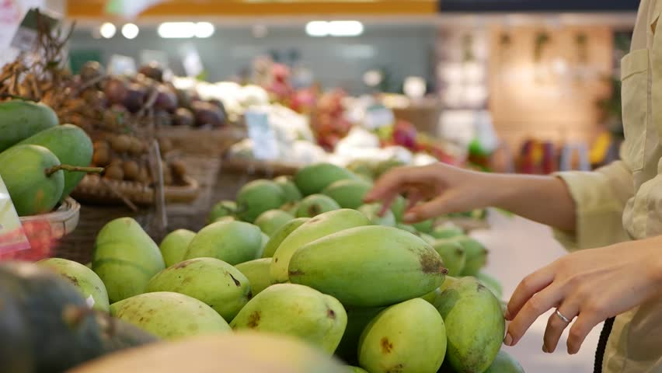
e. Understanding Machine Learning with an Analogy
As a Human: Let’s suppose one day you went for shopping mangoes. The vendor had a cart full of mangoes from where you could handpick the mangoes, get them weighed and pay according to the rate fixed per Kg.
Task: How will you choose the best mangoes?

Slide 21
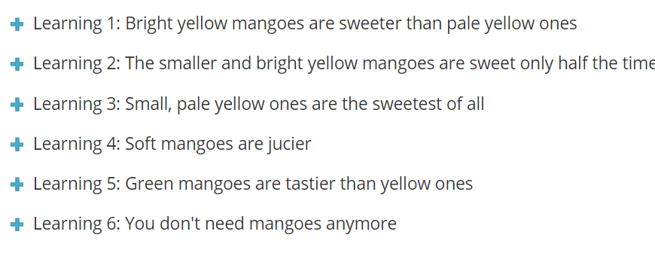
Set of learning,
Given below is set of learning, human gains from his experience of shopping mangoes, you can drill it down to have a further look at it in detail. Go through it once, you will relate it to machine learning very easily.

Slide 22
Learning 1
Experience 1:
You were informed that bright and yellow mangoes are sweeter than pale and yellow ones.
So you make a simple rule: pick only from the bright yellow mangoes. You check the colour of the mangoes, pick the bright yellow ones, pay up, and return home. Right?

Slide 23
Learning2
Experience 2:
Now when you went home and tasted the mangoes, some of them were not sweet as you thought. You are worried as your wisdom was insufficient. You concluded that when it comes shopping mangoes, you have to look for more than just the colours.
After a lot of pondering and tasting different types of mangoes,you concluded that the bigger and bright yellow mangoes are guaranteed to be sweet, while the smaller, bright yellow mangoes are sweet only half the time (i.e. if you bought 100 bright yellow mangoes (50 will be big in size and rest 50 will be small), then the 50 big mangoes will all be sweet, while out of the 50 small ones, only 25 mangoes will turn out to be sweet). You will then update your rule about the mango shopping and from next time you will keep this in mind.

Slide 24
Learning 3
Experience 3: Tragedy: Next time at the market, you see that your favorite vendor has gone out of town. You decide to buy from a different vendor, who supplies mangoes grown from a different part of the country. Now, you realize that the rule which you had learnt (that big, bright yellow mangoes are the sweetest) is no longer applicable. You have to learn from scratch. You taste a mango of each kind from this vendor and realize that the small, pale yellow ones are in fact the sweetest of all.

Slide 25
Learning 4
Experience 4: One day your cousin visits you from another city. You decide to treat her with mangoes. But she is like “I don’t care about the sweetness of a mango, I only want the juiciest ones”. Now once again, you run your experiments, tasting all kinds of mangoes, and realizing that the softer ones are juicier.

Slide 26
Learning 5
Experience 5: Later on, you move to a different part of the world and you found that the mangoes here taste surprisingly different from your home country. You realized that for this country the green mangoes are tastier than the yellow ones.

Slide 27
Learning 6
Experience 6: You marry someone who hates mangoes but loves apples instead. Now you go for shopping oranges instead of mangoes. Now, all your accumulated knowledge about mangoes is worthless. Now you have to learn everything about the correlation between the physical characteristics and the taste of apples, by the same method of experimentation.

Slide 28
What if you have to write a code for it?
As a Human Written Code: Now, imagine you were asked to write a computer program to choose your mangoes (or oranges). You might write the following rules/algorithm:
if is bright yellow and size is big and sold by: mango is sweet. if (soft): mango is juicy
You would use these rules to choose the mangoes.

Slide 29
Conclusion as a human:
But every time you make a new observation from your experiments, you have to modify the list of rules manually.
You have to understand the details of all the factors affecting the quality of mangoes.
If the problem gets complicated enough, it might get difficult for you to make accurate rules by hand that covers all possible types of mangoes.
This will take a lot of research and effort and not everyone has this amount of time.

Slide 30
Training and Testing Phase
Machine Learning algorithms are an evolution of normal algorithms. They make your programs “smarter”, by allowing them to automatically learn from the data you provide. The algorithm is mainly divided into:
Training Phase
Testing phase

Slide 31

Training Phase
You take a randomly selected specimen of mangoes from the market (training data), make a table of all the physical characteristics of each mango, like color, size, shape, grown in which part of the country, sold by which vendor, etc (features), along with the sweetness, juiciness, ripeness of that mango (output variables).
You feed this data to the machine learning algorithm (classification/regression), and it learns a model of the correlation between an average mango’s physical characteristics, and its quality.

Slide 32

Testing Phase
Next time when you go shopping, you will measure the characteristics of the mangoes which you are purchasing(test data)and feed it to the Machine Learning algorithm.
It will use the model which was computed earlier to predict if the mangoes are sweet, ripe and/or juicy.
The algorithm may internally use the rules, similar to the one you manually wrote earlier (for eg, a decision tree).
Finally, you can now shop for mangoes with great confidence, without worrying about the details of how to choose the best mangoes.

Slide 33
Conclusion as an Algorithm
You know what! you can make your algorithm improve over time (reinforcement learning) so that it will improve its accuracy as it gets trained on more and more training dataset. In case it makes a wrong prediction it will update its rule by itself.
The best part of this is, you can use the same algorithm to train different models. You can create one each for predicting the quality of apples, grapes, bananas, or whatever you want.

Slide 34
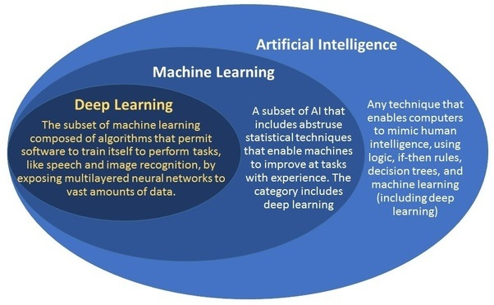
f. AI , ML and DL

Slide 35
g.Open Source and Commercial Machine Learning Tools

Slide 36
Open Source Tools
OpenAI
TensorFlow
Keras
Charnn
PaddlePAddle
CNTK
R
Monte Carlo ML Library
Octave Forge
Scikit Learn
Shogun
Accord.NET Framework
Spark MLlib
H20
Coudera Oryx
GoLearn
Weka
Deep Learn.js
ConvNet.Js

Slide 37
Commercial Tools
Microsoft Azure Machine Learning
SAS Enterprise Miner
IBM SPSS Modeler
RapidMiner
Apache Mahout
MATLAB
Oracle Data Mining

Slide 38
Steps involved in machine learning
Collecting Data
Cleaning Data
Analyze Data
Build Model
Train the Algorithm
Test the Algorithm
Use it

Slide 39
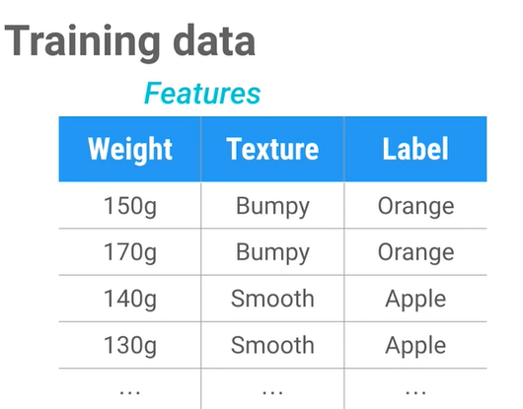
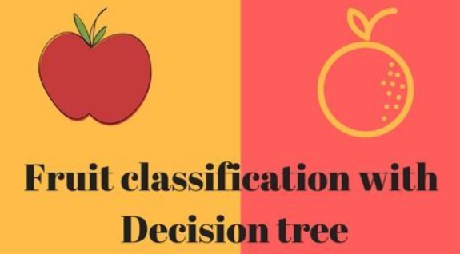
i. Simple Machine Learning Application

Slide 40
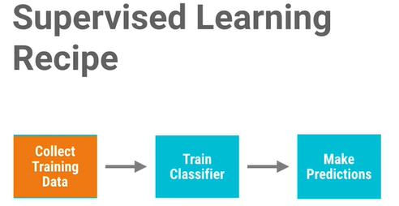

Slide 41
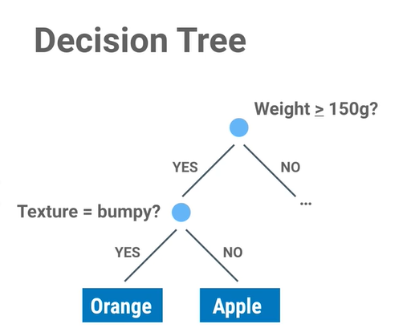
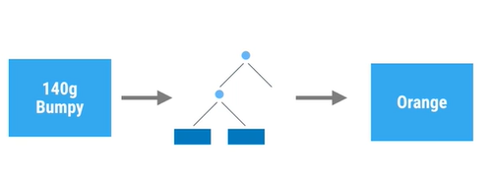

Slide 42
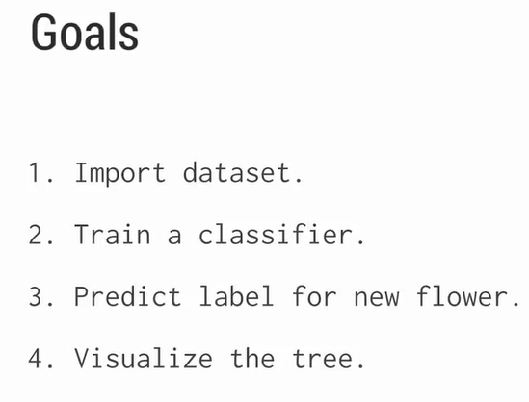

Slide 43
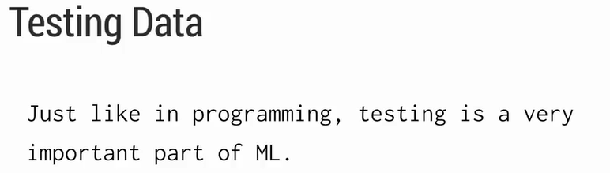

Slide 44
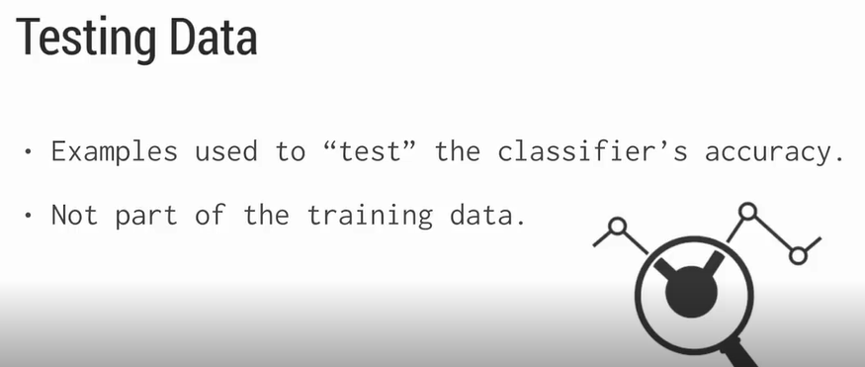

Slide 45
Hands On

Slide 46
End of Day1 Part1

Slide 47
2 .Data Preprocessing

Slide 48
Data Sets
A data set (or dataset) is a collection of data.
Most commonly a data set corresponds to the contents of a single database table, or a single statistical data matrix, where every column of the table represents a particular variable, and each row corresponds to a given member of the data set in question.
The data set lists values for each of the variables, such as height and weight of an object, for each member of the data set. Each value is known as a datum.

Slide 49
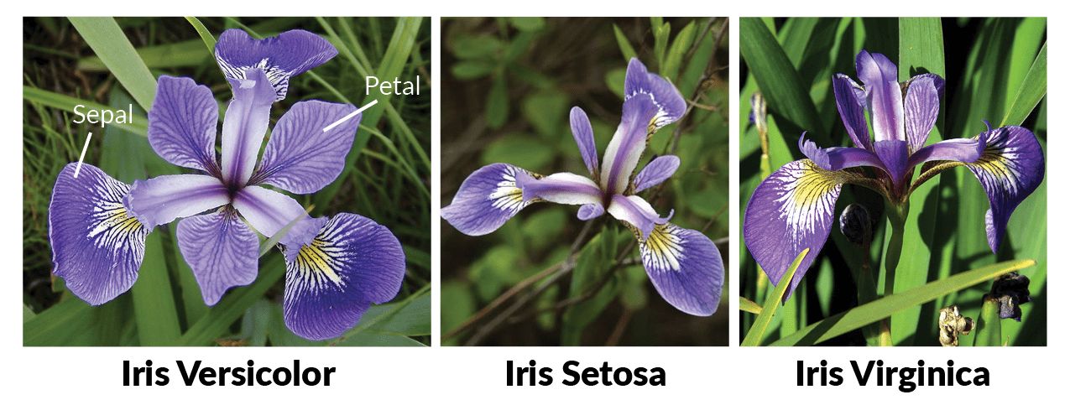

Slide 50
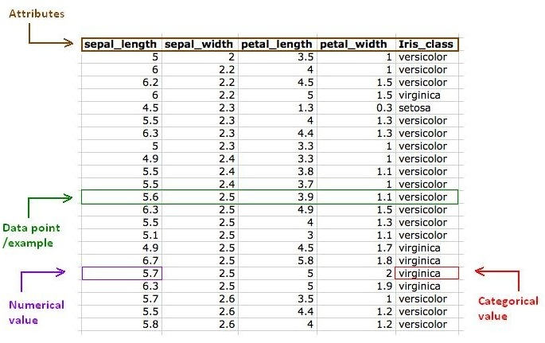

Slide 51
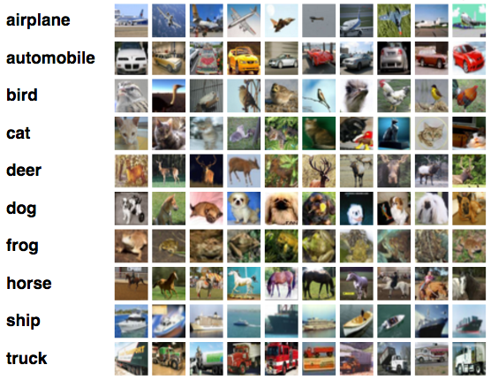

Slide 52
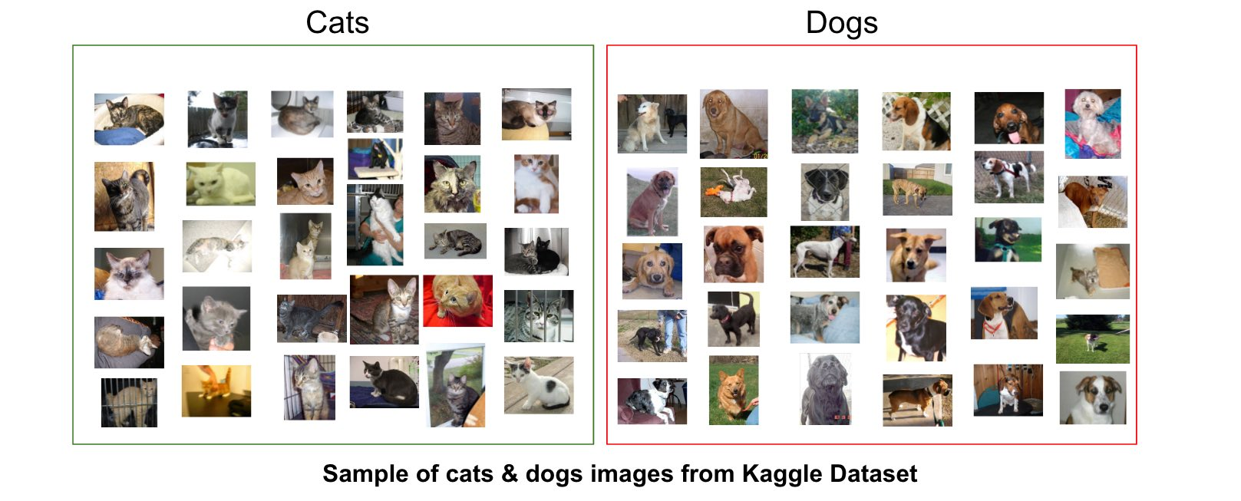

Slide 53
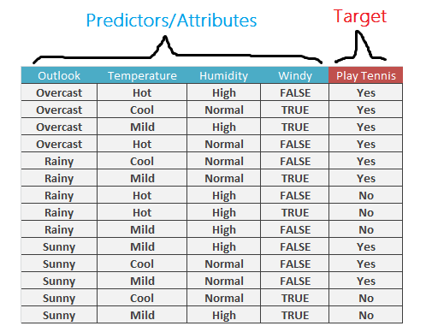
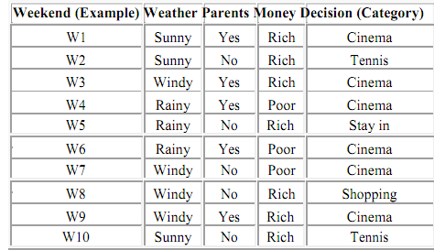

Slide 54
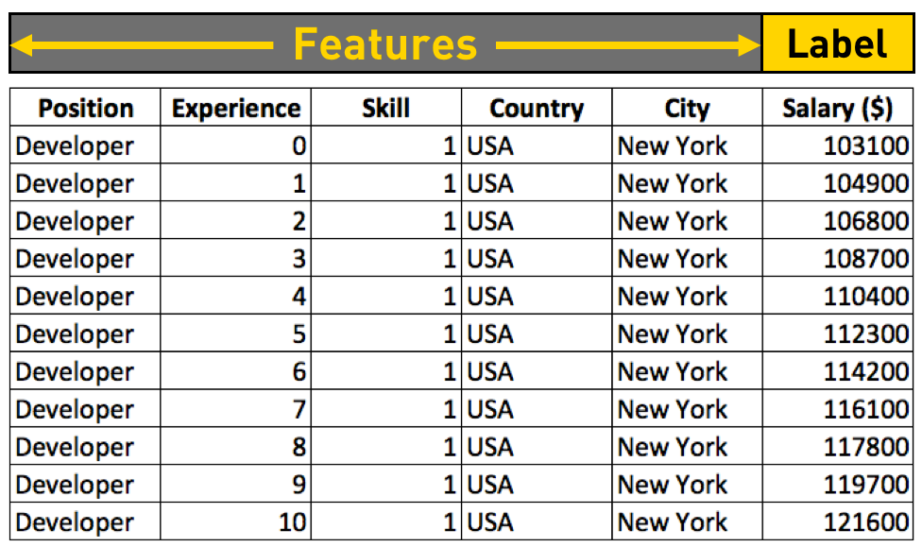

Slide 55
Classic Data Sets
Iris flower data set – Multivariate data set introduced by Ronald Fisher (1936).^{[7]}
MNIST database – Images of handwritten digits commonly used to test classification, clustering, and image processing algorithms
World University Rankings – Ranking universities can be difficult and controversial. There are hundreds of ranking systems, and they rarely reach a consensus. This dataset contains three global university rankings.
IMDB 5000 Movie Dataset – This dataset explores the question of whether we can anticipate a movie’s popularity before it’s even released.
Wine Quality (Regression) – Properties of red and white vinho verde wine samples from the north of Portugal. The goal is to model wine quality based on physicochemical tests. (We also have a tutorial.)
Credit Card Default (Classification) – Predicting credit card default is a valuable and common use for machine learning. This rich dataset includes demographics, payment history, credit, and default data.
US Census Data (Clustering) – Clustering based on demographics is a tried and true way to perform market research and segmentation.
ImageNet – ImageNet hosts a computer vision competition every year, and many consider it to be the benchmark for modern performance. The current image dataset has 1000 different classes.
YouTube 8M – Ready to tackle videos, but can’t spare terabytes of storage? This dataset contains millions of YouTube video ID’s and billions of audio and visual features that were pre-extracted using the latest deep learning models.
EOD Stock Prices - End of day stock prices, dividends, and splits for 3,000 US companies, curated by the Quandl community.
Zillow Real Estate Research - Home prices and rents by size, type, and tier, sliced by zip code, neighborhood, city, metro area, county and state.
Global Education Statistics - Over 4,000 internationally comparable indicators for education access, progression, completion, literacy, teachers, population, and expenditures.
Million Song Dataset - Large, rich dataset for music recommendations. You can start with a pure collaborative filter and then expand it with other methods such as content-based models or web scraping.

Slide 56
Types of Data
Raw Data
Structured Data
Unstructured Data

Slide 57
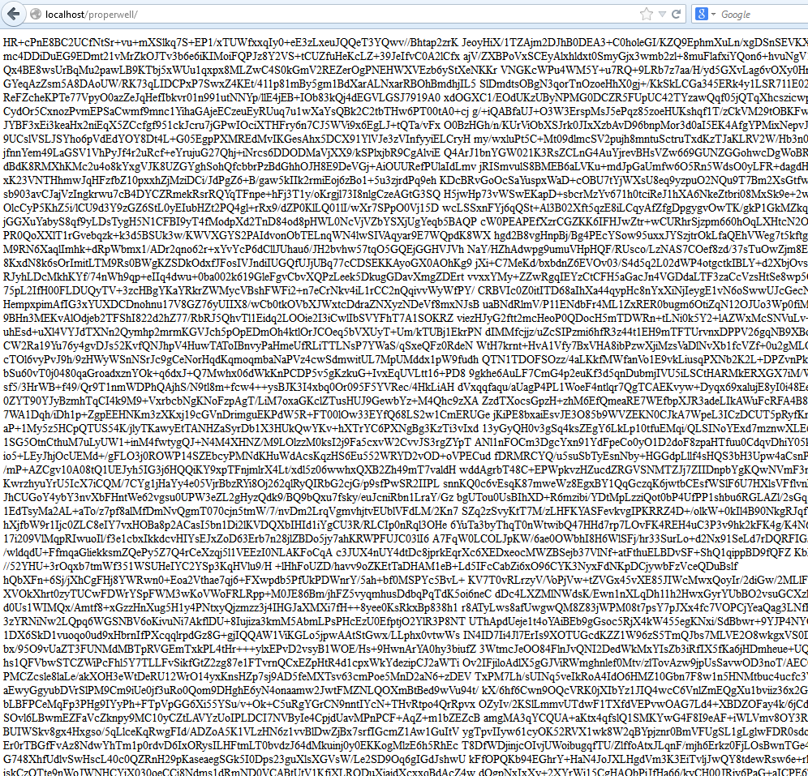
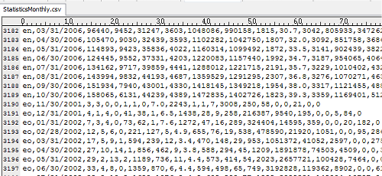
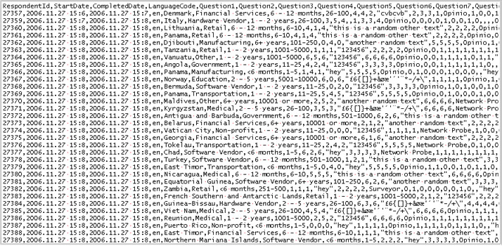

Slide 58
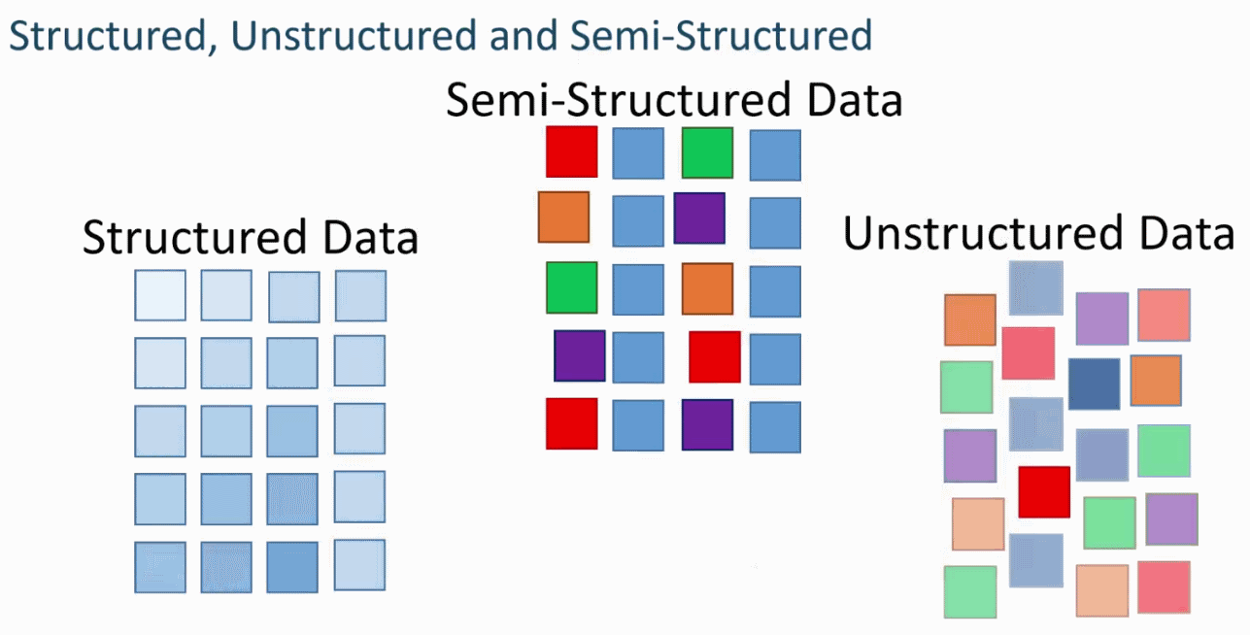

Slide 59
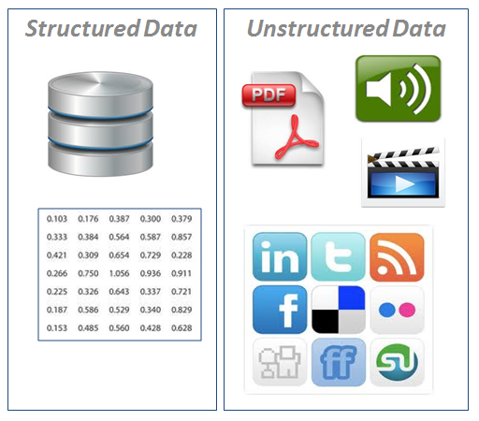
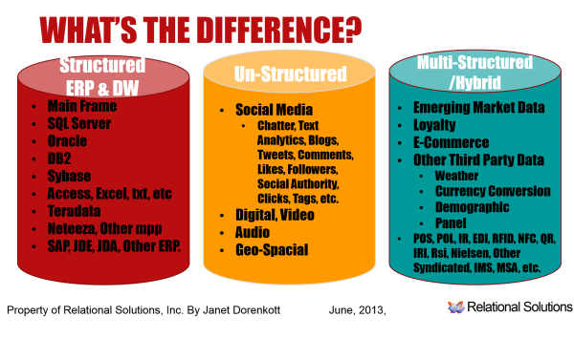

Slide 60
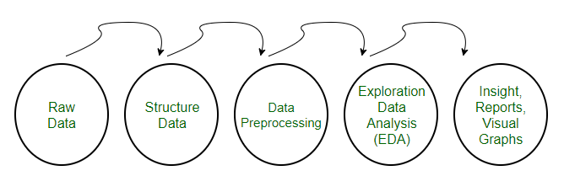
Data Preprocessing for Machine learning in Python
Pre-processing refers to the transformations applied to our data before feeding it to the algorithm.
Data Preprocessing is a technique that is used to convert the raw data into a clean data set. In other words, whenever the data is gathered from different sources it is collected in raw format which is not feasible for the analysis.

Slide 61
Need of Data Preprocessing
For achieving better results from the applied model in Machine Learning projects the format of the data has to be in a proper manner.
Some specified Machine Learning model needs information in a specified format, for example, Random Forest algorithm does not support null values, therefore to execute random forest algorithm null values have to be managed from the original raw data set.
Another aspect is that data set should be formatted in such a way that more than one Machine Learning and Deep Learning algorithms are executed in one data set, and best out of them is chosen.

Slide 62
Data Quality: Why Preprocess the Data?
Measures for data quality: A multidimensional view
Accuracy: correct or wrong, accurate or not
Completeness: not recorded, unavailable, …
Consistency: some modified but some not, dangling, …
Timeliness: timely update?
Believability: how trustable the data are correct?
Interpretability: how easily the data can be understood?

Slide 63
Major Tasks in Data Preprocessing
Data cleaning
Fill in missing values, smooth noisy data, identify or remove outliers, and resolve inconsistencies
Data integration
Integration of multiple databases, data cubes, or files
Data reduction
Dimensionality reduction
Numerosity reduction
Data compression
Data transformation and data discretization
Normalization
Concept hierarchy generation

Slide 64
Data Cleaning
Data in the Real World Is Dirty: Lots of potentially incorrect data, e.g., instrument faulty, human or computer error, transmission error
Incomplete(missing): lacking attribute values, lacking certain attributes of interest, or containing only aggregate data
e.g., Occupation=“ ” (missing data)
noisy: containing noise, errors, or outliers
e.g., Salary=“−10” (an error)
inconsistent: containing discrepancies in codes or names, e.g.,
Age=“42”, Birthday=“03/07/2010”
Was rating “1, 2, 3”, now rating “A, B, C”
discrepancy between duplicate records
Intentional (e.g., disguised missing data)
Jan. 1 as everyone’s birthday?

Slide 65
Incomplete (Missing) Data
Data is not always available
E.g., many tuples have no recorded value for several attributes, such as customer income in sales data
Missing data may be due to
equipment malfunction
inconsistent with other recorded data and thus deleted
data not entered due to misunderstanding
certain data may not be considered important at the time of entry
not register history or changes of the data
Missing data may need to be inferred

Slide 66
How to Handle Missing Data?
Ignore the tuple: usually done when class label is missing (when doing classification)—not effective when the % of missing values per attribute varies considerably
Fill in the missing value manually: tedious + infeasible?
Fill in it automatically with
a global constant : e.g., “unknown”, a new class?!
the attribute mean
the attribute mean for all samples belonging to the same class: smarter
the most probable value: inference-based such as Bayesian formula or decision tree

Slide 67
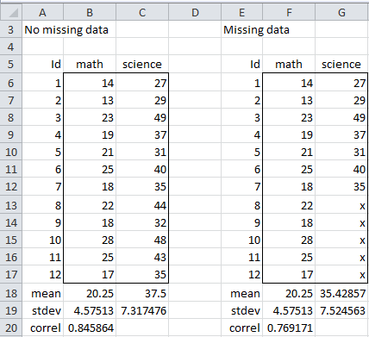
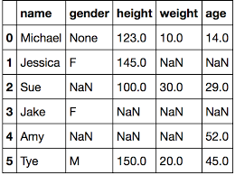

Slide 68
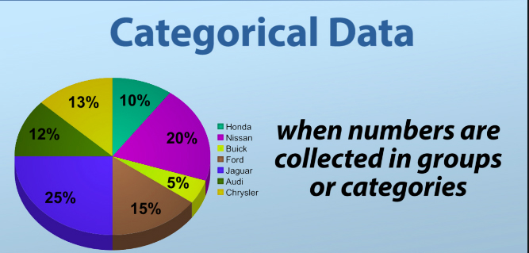
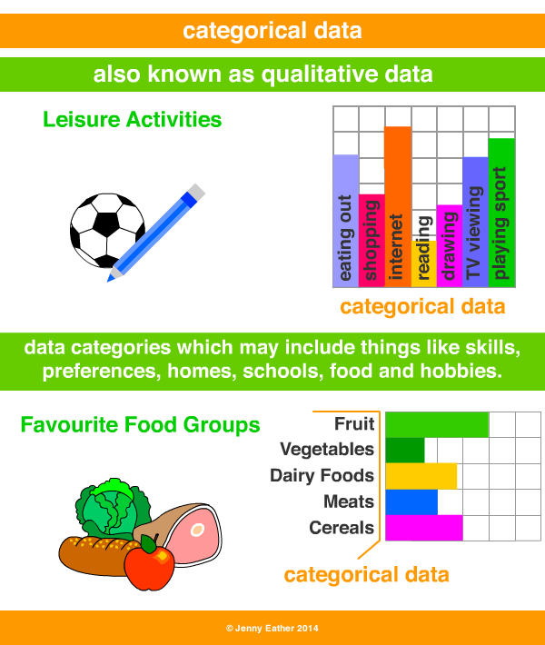
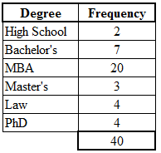

Slide 69
Noisy Data
Noise: random error or variance in a measured variable
Incorrect attribute values may be due to
faulty data collection instruments
data entry problems
data transmission problems
technology limitation
inconsistency in naming convention
Other data problems which require data cleaning
duplicate records
incomplete data
inconsistent data
69
Notes:
69

Slide 70
Preprocessing the Data in Python
In our daily life, we deal with lots of data but this data is in raw form. To provide the data as the input of machine learning algorithms, we need to convert it into a meaningful data.
That is where data preprocessing comes into picture. In other simple words, we can say that before providing the data to the machine learning algorithms we need to preprocess the data.

Slide 71
Importing Libraries
Hands On

Slide 72
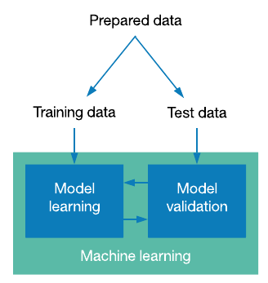
Training and test data

Slide 73
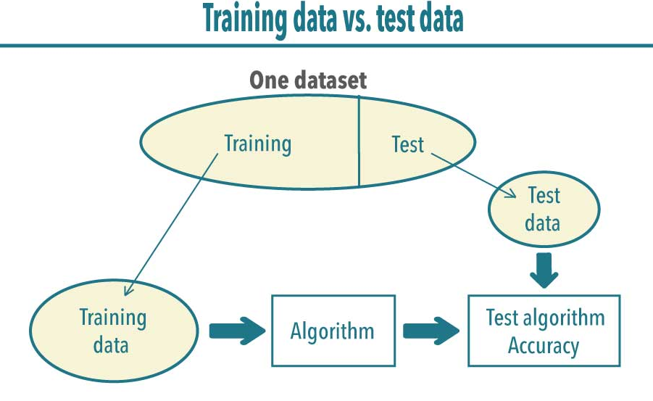

Slide 74
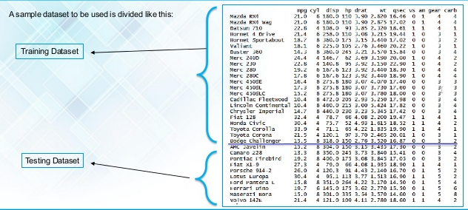

Slide 75
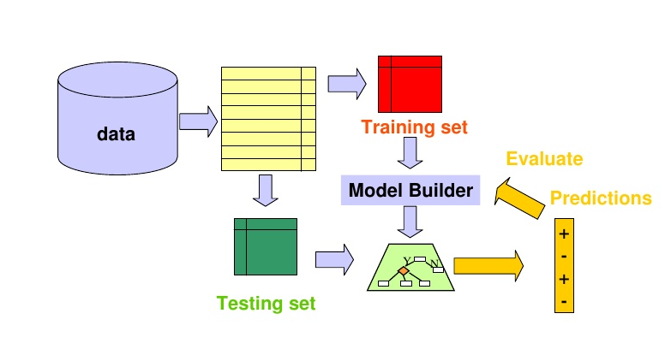

Slide 76
Training , Testing and Validation Data set
Training Dataset: A set of examples used for learning, that is to fit the parameters [i.e., weights] of the classifier or model.
Validation Dataset: The sample of data used to provide an unbiased evaluation of a model fit on the training dataset while tuning model hyperparameters. A set of examples used to tune the parameters [i.e., architecture, not weights] of a classifier, for example to choose the number of hidden units in a neural network.
Test Dataset: The sample of data used to provide an unbiased evaluation of a final model fit on the training dataset. A set of examples used only to assess the performance [generalization] of a fully specified classifier.
Training set: Is used for finding Nearest neighbors.
Validation set: Is for finding different k which is applying to train set.
Test set: Is used for finding the maximum accuracy and unseen data in future.

Slide 77
Hands on

Slide 78
Data preprocessing steps
Step 1 − Importing the useful packages
Step 2 − Defining sample data
Step3 − Applying preprocessing technique

Slide 79
Step 1 − Importing the useful packages
If we are using Python then this would be the first step for converting the data into a certain format, i.e., preprocessing. It can be done as follows −
import numpy as np
from sklearn import preprocessing
Here we have used the following two packages −
NumPy − Basically NumPy is a general purpose array-processing package designed to efficiently manipulate large multi-dimensional arrays of arbitrary records without sacrificing too much speed for small multi-dimensional arrays.
Sklearn.preprocessing − This package provides many common utility functions and transformer classes to change raw feature vectors into a representation that is more suitable for machine learning algorithms.

Slide 80
Step 2 − Defining sample data
After importing the packages, we need to define some sample data so that we can apply preprocessing techniques on that data.
We will now define the following sample data −
input_data = np.array([2.1, -1.9, 5.5],
[-1.5, 2.4, 3.5],
[0.5, -7.9, 5.6],
[5.9, 2.3, -5.8 ]])

Slide 81
Step3 − Applying preprocessing technique
In this step, we need to apply any of the preprocessing techniques.

Slide 82
Techniques for Data Preprocessing
Scaling /Rescaling : # Min max scaling
Standardization
Normalization
L1 Normalization
L2 Normalization
Binarization
Mean Removal
Labeling the Data
One Hot Encoding

Slide 83
1. Scaling or Rescaling Data
When your data is comprised of attributes with varying scales, many machine learning algorithms can benefit from rescaling the attributes to all have the same scale.
The attributes are often rescaled into the range between 0 and 1. This is useful for optimization algorithms in used in the core of machine learning algorithms like gradient descent. It is also useful for algorithms that weight inputs like regression and neural networks and algorithms that use distance measures like K-Nearest Neighbors.
You can rescale your data using scikit-learn using the MinMaxScaler class.

Slide 84
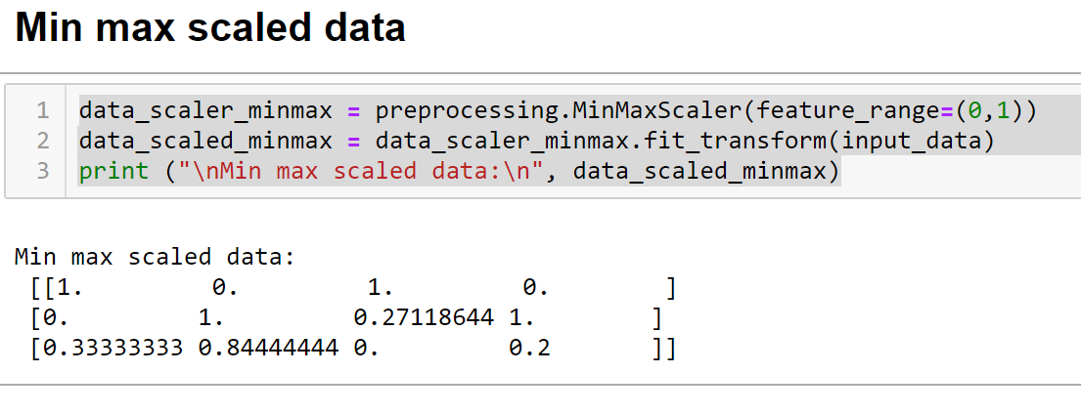
Example : Min max scaled data

Slide 85
2 . Standardize Data
Standardization is a useful technique to transform attributes with a Gaussian distribution and differing means and standard deviations to a standard Gaussian distribution with a mean of 0 and a standard deviation of 1.
It is most suitable for techniques that assume a Gaussian distribution in the input variables and work better with rescaled data, such as linear regression, logistic regression and linear discriminate analysis.
You can standardize data using scikit-learn with the StandardScaler class.

Slide 86
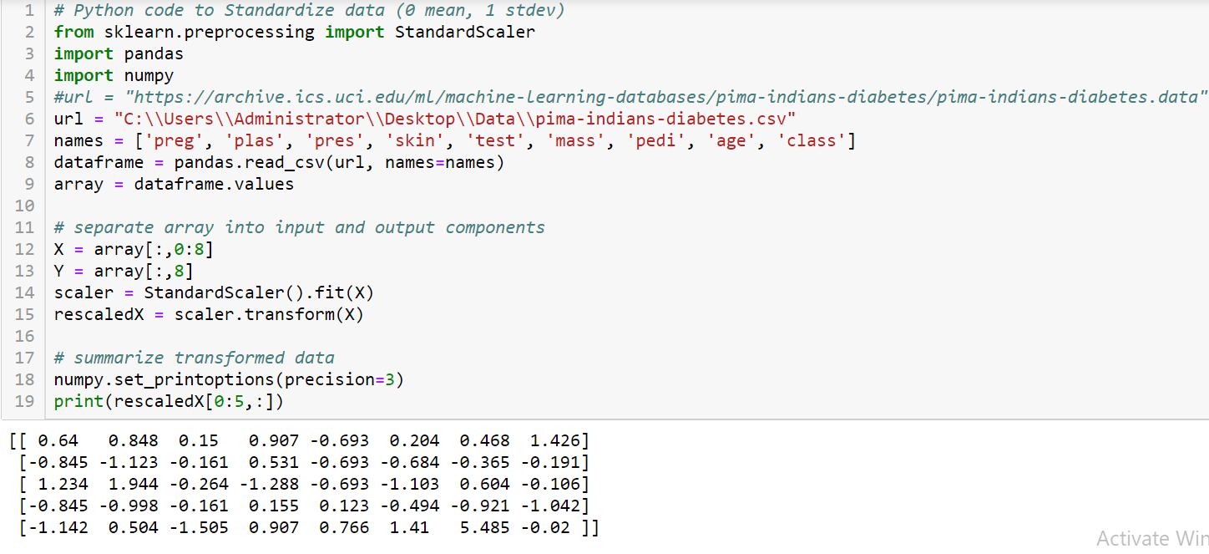

Slide 87
3. Normalization
Normalizing in scikit-learn refers to rescaling each observation (row) to have a length of 1 (called a unit norm in linear algebra).
This preprocessing can be useful for sparse datasets (lots of zeros) with attributes of varying scales when using algorithms that weight input values such as neural networks and algorithms that use distance measures such as K-Nearest Neighbors.
You can normalize data in Python with scikit-learn using the Normalizer class.
It is another data preprocessing technique that is used to modify the feature vectors. Such kind of modification is necessary to measure the feature vectors on a common scale. Followings are two types of normalization which can be used in machine learning −

Slide 88
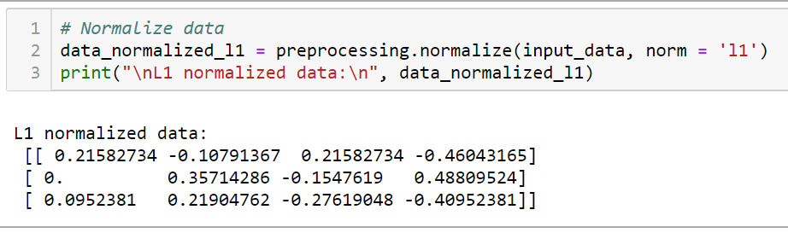
L1 Normalization
It is also referred to as Least Absolute Deviations. This kind of normalization modifies the values so that the sum of the absolute values is always up to 1 in each row. It can be implemented on the input data with the help of the following Python code −

Slide 89
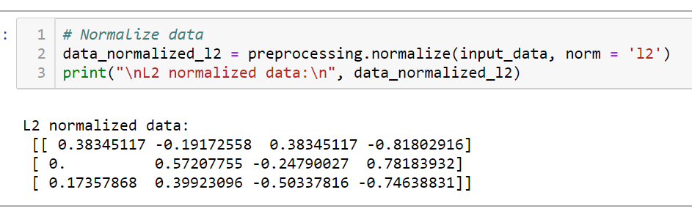
L2 Normalization
It is also referred to as least squares. This kind of normalization modifies the values so that the sum of the squares is always up to 1 in each row. It can be implemented on the input data with the help of the following Python code −

Slide 90
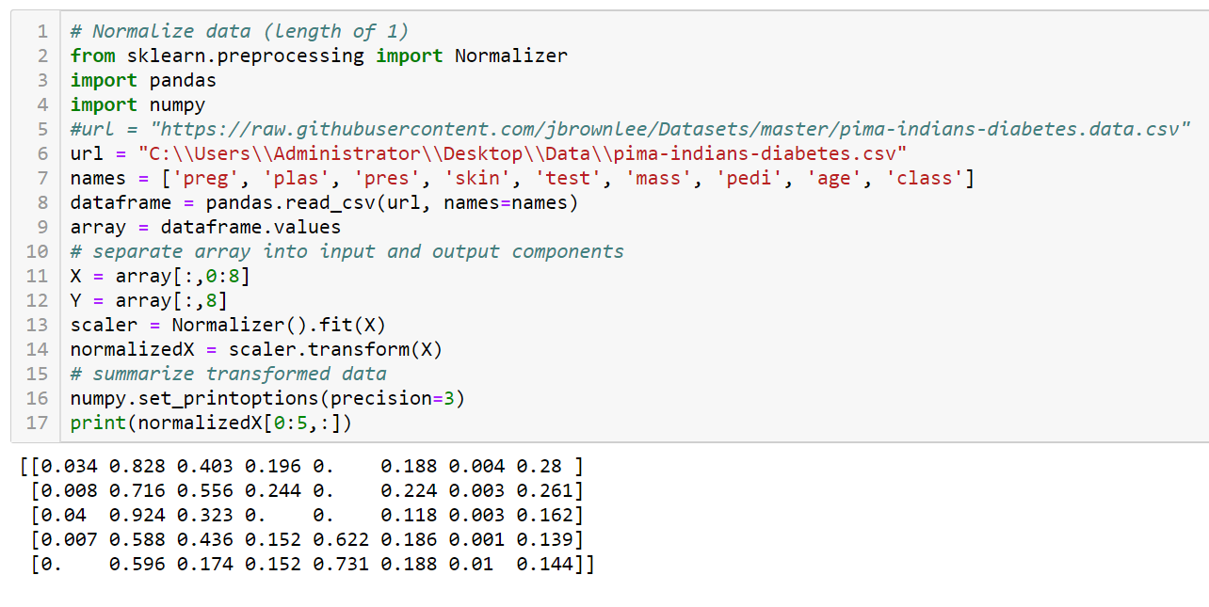

Slide 91

4.Binarization
You can transform your data using a binary threshold. All values above the threshold are marked 1 and all equal to or below are marked as 0.
This is called binarizing your data or threshold your data. It can be useful when you have probabilities that you want to make crisp values. It is also useful when feature engineering and you want to add new features that indicate something meaningful.
You can create new binary attributes in Python using scikit-learn with the Binarizer class.

Slide 92

5. Mean Removal
It is another very common preprocessing technique that is used in machine learning. Basically it is used to eliminate the mean from feature vector so that every feature is centered on zero.
We can also remove the bias from the features in the feature vector. For applying mean removal preprocessing technique on the sample data, we can write the Python code shown below.
The code will display the Mean and Standard deviation of the input data − Now, the code below will remove the Mean and Standard deviation of the input data −

Slide 93
6. Labelling the Data
We already know that data in a certain format is necessary for machine learning algorithms. Another important requirement is that the data must be labelled properly before sending it as the input of machine learning algorithms. For example, if we talk about classification, there are lot of labels on the data. Those labels are in the form of words, numbers, etc. Functions related to machine learning in sklearn expect that the data must have number labels. Hence, if the data is in other form then it must be converted to numbers. This process of transforming the word labels into numerical form is called label encoding.
Label encoding steps
Follow these steps for encoding the data labels in Python −
Step 1 − Importing the useful packages¶
If we are using Python then this would be first step for converting the data into certain format, i.e., preprocessing. It can be done as follows −

Slide 94
Label encoding steps
Step 1 − Importing the useful packages
Step 2 − Defining sample labels
Step 3 − Creating & training of label encoder object
Step 4 − Checking the performance by encoding random ordered list
Step 5 − Checking the performance by decoding a random set of numbers −

Slide 95


Slide 96


Slide 97


Slide 98


Slide 99
Dealing with Missing Data
Hands on

Slide 100
Preprocessing Techniques Covered
Standardization and Normalization
Missing value replacement
Resampling
Discretization
Feature Selection
Dimensionality Reduction: PCA

Slide 101
Day2

Slide 102
Types of Machine Learning
Supervised Learning – Train Me!
Unsupervised Learning – I am self sufficient in learning
Reinforcement Learning – My life My rules! (Hit & Trial)

Slide 103



Types of Machine Learning Algorithm
Reinforcement Learning
Supervised Learning
Unsupervised Learning

Slide 104
Types of ML
What is Supervised Learning?
Supervised Learning is the one, where you can consider the learning is guided by a teacher. We have a dataset which acts as a teacher and its role is to train the model or the machine. Once the model gets trained it can start making prediction or decision when new data is given to it.
What is Unsupervised Learning?
The model learns through observation and finds structures in the data. Once the model is given a dataset, it automatically finds patterns and relationships in the dataset by creating clusters in it. What it cannot do is add labels to the cluster, like it cannot say this a group of apples or mangoes, but it will separate all the apples from mangoes.
Suppose we presented images of apples, bananas and mangoes to the model, so what it does, based on some patterns and relationships it creates clusters and divides the dataset into those clusters. Now if a new data is fed to the model, it adds it to one of the created clusters.
What is Reinforcement Learning?
It is the ability of an agent to interact with the environment and find out what is the best outcome. It follows the concept of hit and trial method. The agent is rewarded or penalized with a point for a correct or a wrong answer, and on the basis of the positive reward points gained the model trains itself. And again once trained it gets ready to predict the new data presented to it.

Slide 105


Slide 106
Understanding Supervised Learning
Let’s see the mathematical definition of Supervised Learning.
Supervised learning is the one where you have input variables (x) and an output variable (Y) and you use an algorithm to learn the mapping function from the input to the output. it,
Y = f(X)
The goal is to approximate the mapping function so well that whenever you get some new input data (x), the machine can easily predict the output variables (Y) for that data.

Slide 107


Slide 108
Let me rephrase you this in simple terms:
In Supervised machine learning algorithm, every instance of the training dataset consists of input attributes and expected output. The training dataset can take any kind of data as an input like values of a database row, the pixels of an image, or even an audio frequency histogram.
Now let me tell you why this category of machine learning is termed as supervised learning?
This category is termed as supervised learning because the process of an algorithm learning from the training dataset can be thought of as a teacher teaching his students. The algorithm continuously predicts the result on the basis of training data and is continuously corrected by the teacher. The learning continues until the algorithm achieves an acceptable level of performance.

Slide 109

Supervised Learning Use cases
Cortana
Cortana or any speech automated system in your mobile phone trains your voice and then starts working based on this training. This is an application of Supervised Learning

Slide 110

Supervised Learning Use cases
Weather Apps
Predicts the upcoming weather by analyzing the parameters for a given time on some prior knowledge (when its sunny, temperature is higher; when its cloudy, humidity is higher, etc.).

Slide 111

Supervised Learning Use cases
Biometric Attendance
In Biometric Attendance you can train the machine with inputs of your biometric identity – it can be your thumb, iris or ear-lobe, etc. Once the machine is trained it can validate your future input and can easily identify you.

Slide 112
Understanding Unsupervised Learning
So What is Unsupervised Learning?
Mathematically, Unsupervised learning is where you only have input data (X) and no corresponding output variables.
The goal for unsupervised learning is to model the underlying structure or distribution in the data in order to learn more about the data.

Slide 113


Slide 114
Let me rephrase it for you in simple terms:
In the unsupervised learning approach, the sample of a training dataset does not have an expected output associated with them. Using the unsupervised learning algorithms you can detect patterns based on the typical characteristics of the input data. Clustering can be considered as an example of machine learning task that uses the unsupervised learning approach. The machine then groups similar data samples and identify different clusters within the data.
Now let me tell you why this category of machine learning is known as unsupervised learning?
Well, this category of machine learning is known as unsupervised because unlike supervised learning there is no teacher. Algorithms are left on their own to discover and return the interesting structure in the data.

Slide 115

Unsupervised Learning Usecases
A friend invites you to his party where you meet totally strangers. Now you will classify them using unsupervised learning (no prior knowledge) and this classification can be on the basis of gender, age group, dressing, educational qualification or whatever way you would like. Since you didn’t have any prior knowledge about people and so you just classified them “on-the-go”.

Slide 116

Unsupervised Learning Usecases
Let’s suppose you have never seen a Football match before and by chance watch a video on internet, now you can classify players on the basis of different criterion like Players wearing the same sort of kits are in one class, Players of one style are in one class (players, goalkeeper, referee), or on the basis of playing style(attacker or defender) or whatever way you would observe, you can classify it.

Slide 117
Understanding Reinforcement Learning
So what is Reinforcement Learning?
Reinforcement learning can be thought of as a hit and trial method of learning. The machine gets a Reward or Penalty point for each action it performs. If the option is correct, the machine gains the reward point or gets a penalty point in case of a wrong response.

Slide 118


Slide 119
The reinforcement learning algorithm is all about the interaction between the environment and the learning agent. The learning agent is based on exploration and exploitation.
Exploration is when the learning agent acts on trial and error and Exploitation is when it performs an action based on the knowledge gained from the environment. The environment rewards the agent for every correct action, which is the reinforcement signal. With the aim of collecting more rewards obtained, the agent improves its environment knowledge to choose or perform the next action.

Slide 120
Let see how Pavlov trained his dog using reinforcement training?
Pavlov divided the training of his dog into four stages.
In the first part, Pavlov gave meat to the dog, and in response to the meat, the dog started salivating.
In the next stage he created a sound with a bell, but this time the dogs did not respond anything.
In the third stage, he tried to train his dog by using the bell and then giving them food. Seeing the food the dog started salivating.
Eventually, the dogs started salivating just after hearing the bell, even if the food was not given as the dog was reinforced that whenever the master will ring the bell, he will get the food.

Slide 121


